Slide 1
Student GPA Predictor
A Data Science Project by
Naman Gupta (21BCE0240)
Arvasu Gupta (21BCE0841)

Slide 2


Intro
This presentation aims to highlight the merits and demerits of a GPA predictor by the overall application of Data Science
Prediction Our Model works on given datasets. And predicts grades on given few parameters.
Why? Students have a lot of stress about their future grades, so we have attempted to make a product to solve the problem.
Motto Passing the exam is a simple two-step process:Believe in yourself and back it up with your hard work

Slide 3
ML as a Process: Data Preparation
Needed for several reasons
Some Models have strict data requirements
Scale of the data, data point intervals, etc
Some characteristics of the data may impact dramatically on the model performance
Time on data preparation should not be underestimated
Missing Values
Error Values
Different Scales
Dimensionality
Types Problems
Many others
Scaling
Centering
Skewness
Outliers
Missing Values
Errors
Modeling phase
Raw Data
Data Transformation
Data Ready
Notes:
Add Examples

Slide 4
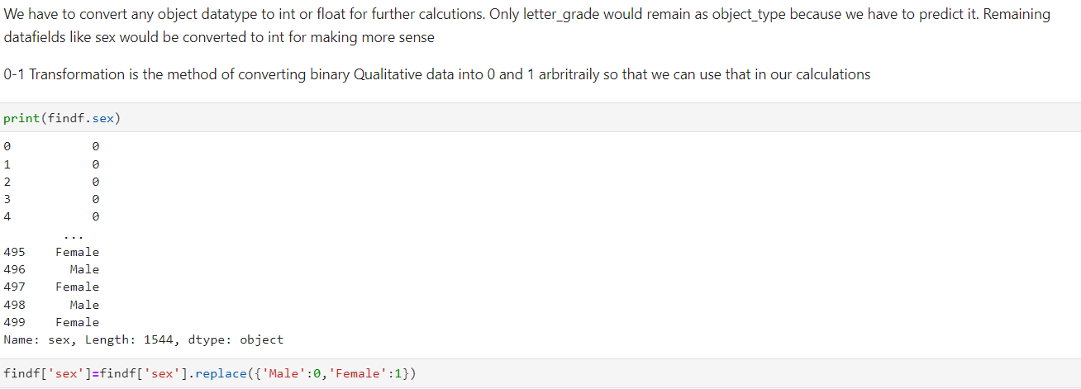
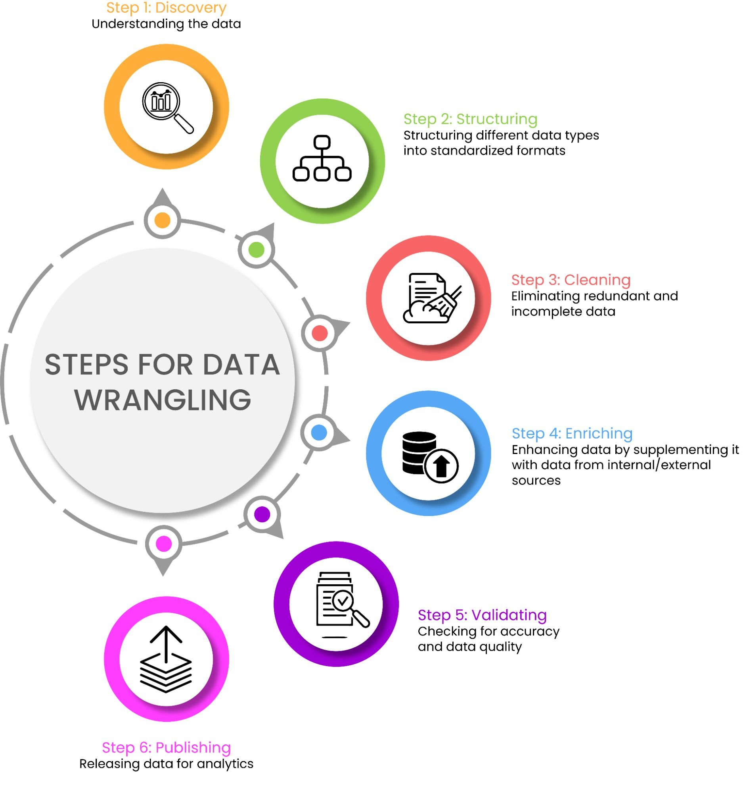
Data Wrangling
According to a NY Times article, data scientists spend 50 to 80 percent of their time “collecting and preparing unruly data, before it can be explored for useful nuggets.”¹
Although CART and CHAID, for example, are able to incorporate missing data without listwise deletion, it still remains important to examine the data and be cognizant of the missing data mechanisms.
There is a wide variety of formats for data, and it takes time and effort to configure data from numerous sources so it can be combined.
Companies are starting up to provide data cleaning and configuring services.

Slide 5
Feature engineering
Determine the predictors (features) to be used is one of the most critical questions
Sometimes we need to add predictors
Reduce Number:
Fewer predictors more interpretable model and less costly
Most of the models are affected by high dimensionality, specially for non-informative predictors
Binning predictors
Wrappers
Multiple models adding and removing parameter
Algorithms that use models as input and performance as output
Genetics Algorithms
Filters
Evaluate the relevance of the predictor
Based normally on correlations
Notes:
Random Forest (tree based) MARS and LASSO internally perform predictor selection
Add Examples

Slide 6
Data Mining: Training, Validation,
and Test Partitions
The purpose of the analysis is both explanatory and predictive.
Need to find the correct level of model complexity.
A model that is not complex enough may lack the flexibility to represent the data, under-fitting.
When the model is too complex it can be influenced by random noise, over-fitting.
For example, if there are outliers, an overly complex model will be fit to them. Then when the model is run on new data, it may be a poor fit.
Partitioning is used to avoid over- or under-fitting. Divide the data into three parts: training, validation, and testing.
The training partition is used to build the model.
The validation partition is set aside and is used to test the accuracy and fine tune the model.
The prediction error is calculated using the validation data.
An increase in the error in the validation set may be caused by over-fitting. The model may need modification.
The test partition is used for evaluating how the model will work on new data.

Slide 7

Building Your Predictive Model
7
Data Collection
Historical Data Extraction and Validation
Institutional student data is collected
Coverage is evaluated for all data points available for inclusion in the SSPM
Configuration
Major and Grade Mapping
Inactive or outdated major or grade records are coded to align with the current-day equivalents.
Outcome Selection
Your SSPM is configured to evaluate likelihood to persist to the next term.
Deployment
Model Fitting and Review
The model (a combination of several penalized logistic regression models applied to different subgroups of students) is trained using the historical data.
Accuracy and Distribution Analysis

Slide 8
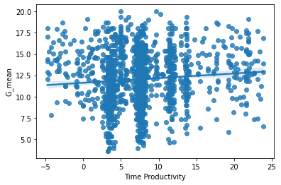
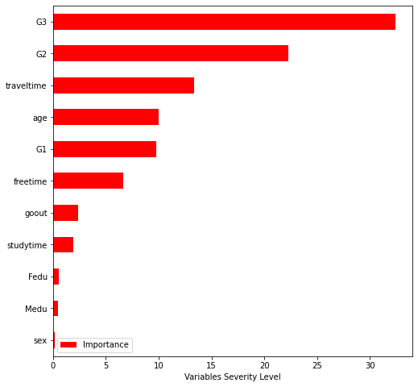
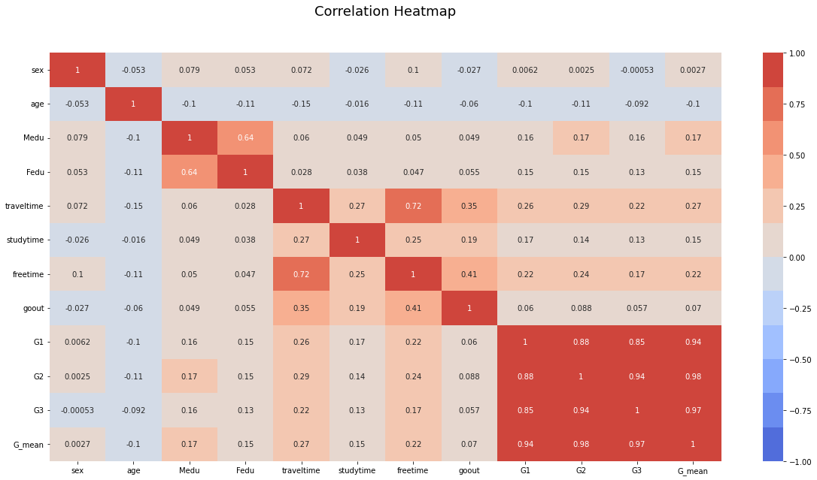
Here we can see few important graphs
This regression curve is for productive time and Means of G1,G2,G3,
This above graph showcases the importance of variables on Letter Grades
This correlation heat map showcases the various correlations of input data sets

Slide 9


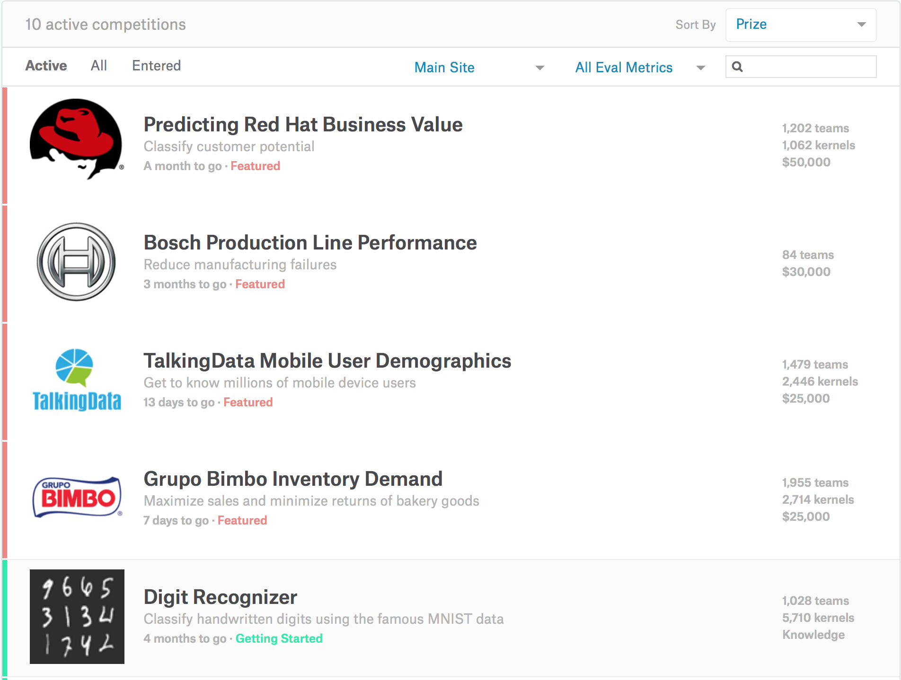



Application of Data Science in real-life

Slide 10
Closing
By this product we intent to instill confidence among students all over world to believe in their consistency of their academics as well as their personal life.
Milestones An attempt to predict our results
What’s next? We believe that we can do better with the insights we have collected, though with the lack of current datasets about grades and other involving facts, we need better ways to collect data

